Slide 1


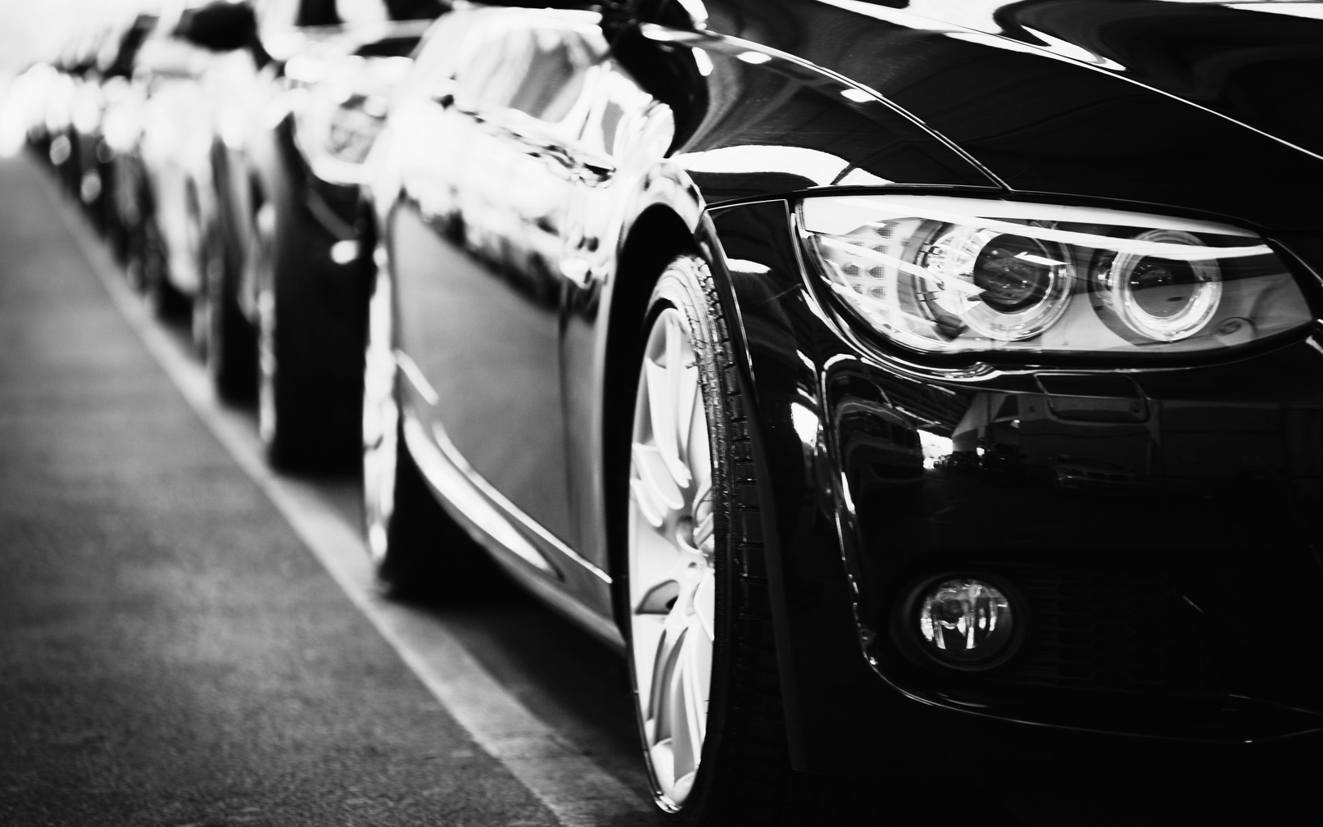
Smart Parking System
Where Technology meets convenience

Slide 2




ABOUT CONTACT BEST ON 2027
OUR TEAM
RIZVI AHMED
MOHAMMAD ALI
A S M FAKHRUDDIN
0112310390
United International University
0112310087
United International University
0112310375
United International University

Slide 3
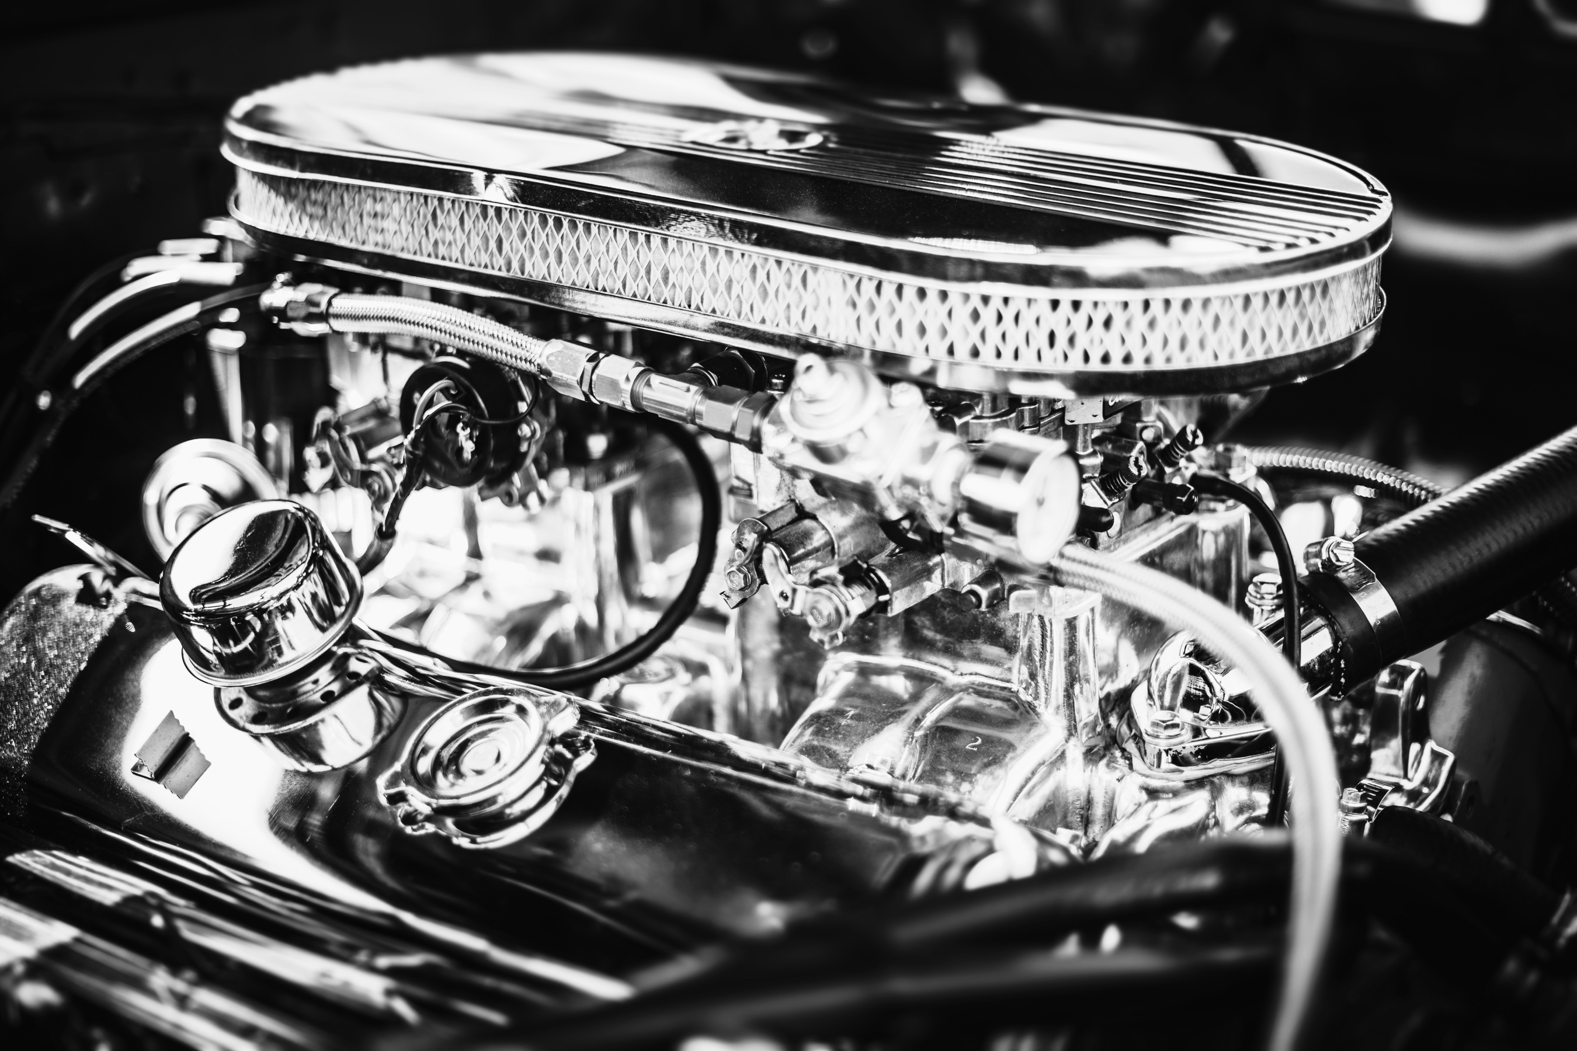
INTRODUCTION
The rapid growth of vehicles in urban areas has made parking a major challenge, leading to congestion, wasted time, and frustration for drivers. A Smart Parking System provides an innovative solution by combining sensors, automation, and real-time monitoring to manage parking spaces more efficiently. Using technologies such as Arduino microcontrollers, IR sensors, servo motors, and LCD displays, the system can automatically detect available slots, control entry and exit barriers, and notify drivers when parking is full. This not only improves the overall parking experience but also reduces the need for manual attendants and contributes to the development of smarter, more sustainable cities.
01

Slide 4
OBJECTIVE
Reduce road congestion through smart slot management
Enable real-time monitoring and automation
Support eco-friendly, efficient city infrastructure
Promote the use of IoT-based systems for sustainable urban development
MISSION
VISION
Reducing congestion through intelligent parking management.
A future where parking is seamless, stress-free, and fully automated

Slide 5
PURPOSE OF THE PROJECT
Our Projects
Elaborate on what you want to discuss.
The main purpose of this project is to reduce traffic congestion in Dhaka city by managing uncontrolled parking activities. Many vehicles waste time and fuel by circling parking areas in search of available space, which increases both road congestion and carbon emissions.
This system provides an effective solution by allowing users to check slot
availability online, book or block parking spaces, and avoid unnecessary
detours.

Slide 6
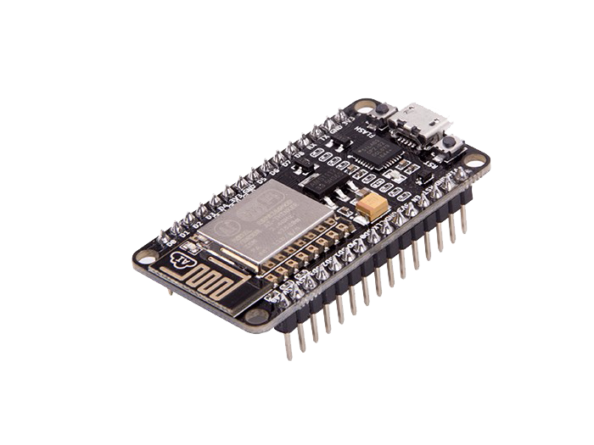
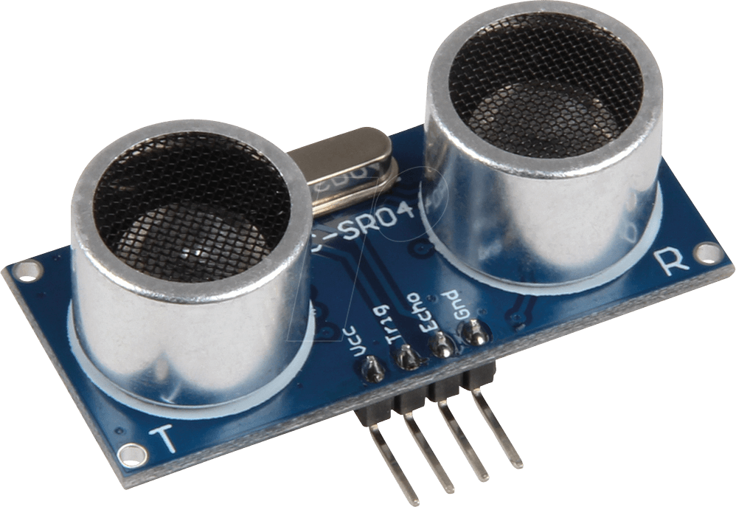
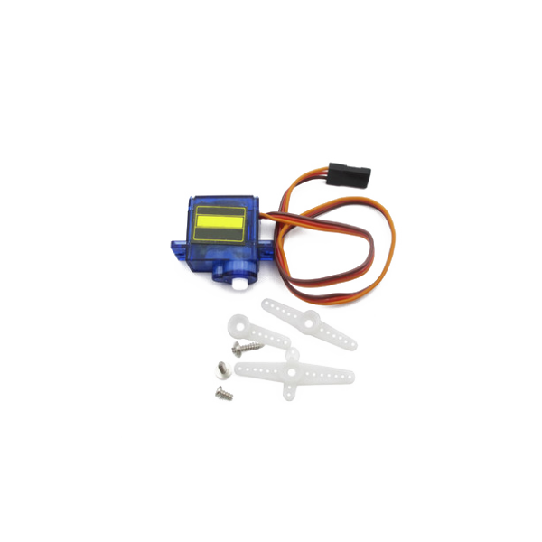
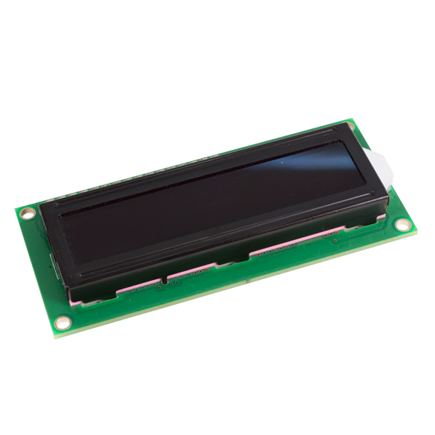
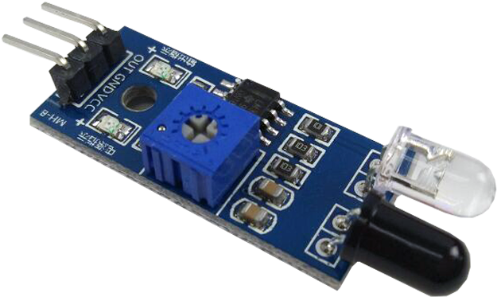
TOOLS AND TECHNOLOGIES
ESP32 Dev Board – main controller with Wi-Fi capability
IR Sensors – detect vehicles at entry, exit, and slots
Ultrasonic Sensor – accurate distance and slot detection
Servo Motor – controls barrier for automated entry/exit
LCD Display (20×4) – shows real-time slot availability
Blynk App – Displays remote parking updates

Slide 7
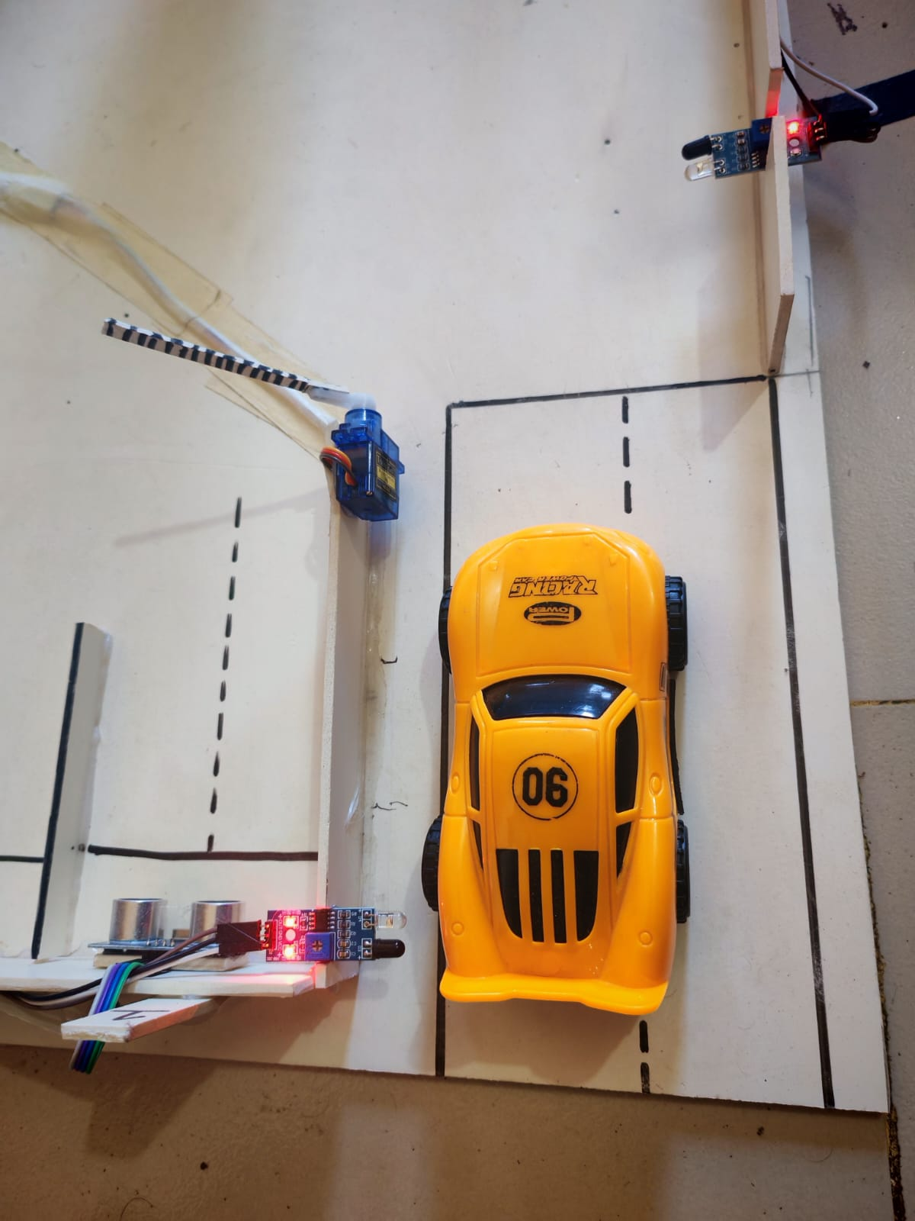
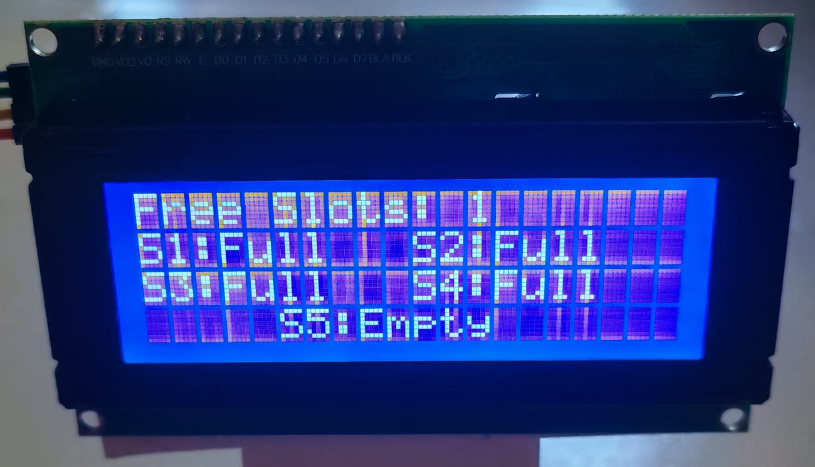
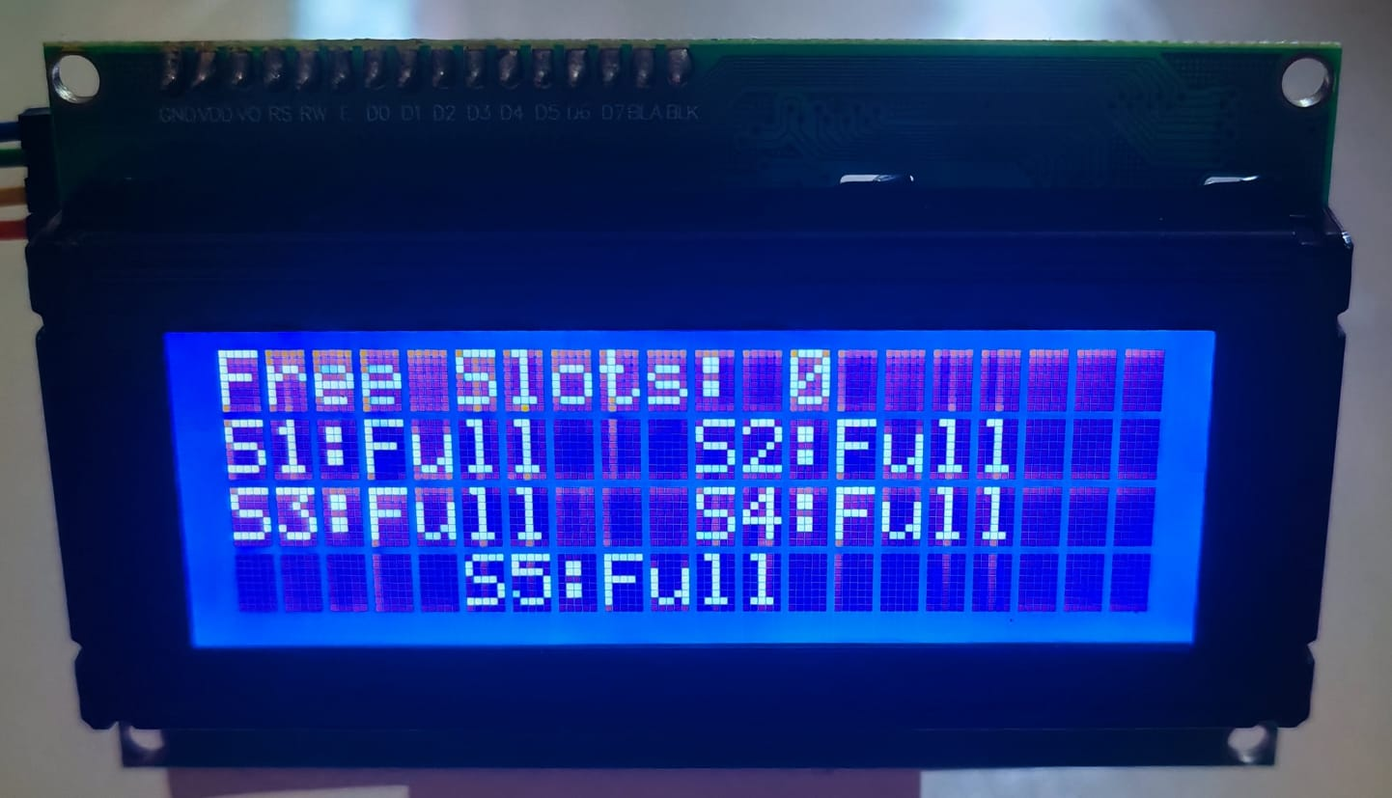
WORK FLOW
STEP BY STEP PROCESS HOW SMART PARKING WORKS
When a car approaches the entry gate, the IR sensor detects it and opens the gate.
Once the car enters, ultrasonic sensors check each slot’s distance to detect which are occupied.
The LCD display updates the number of available slots.

Slide 8
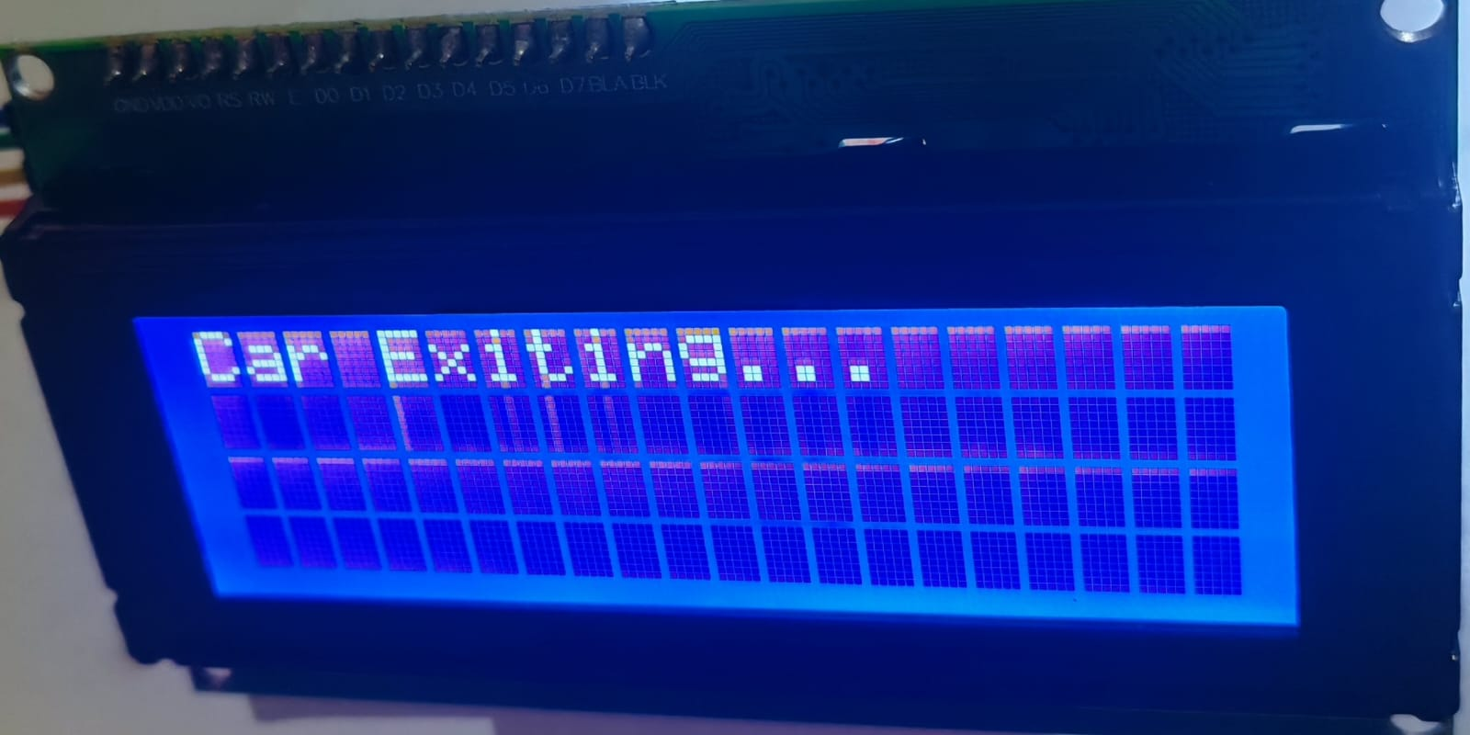
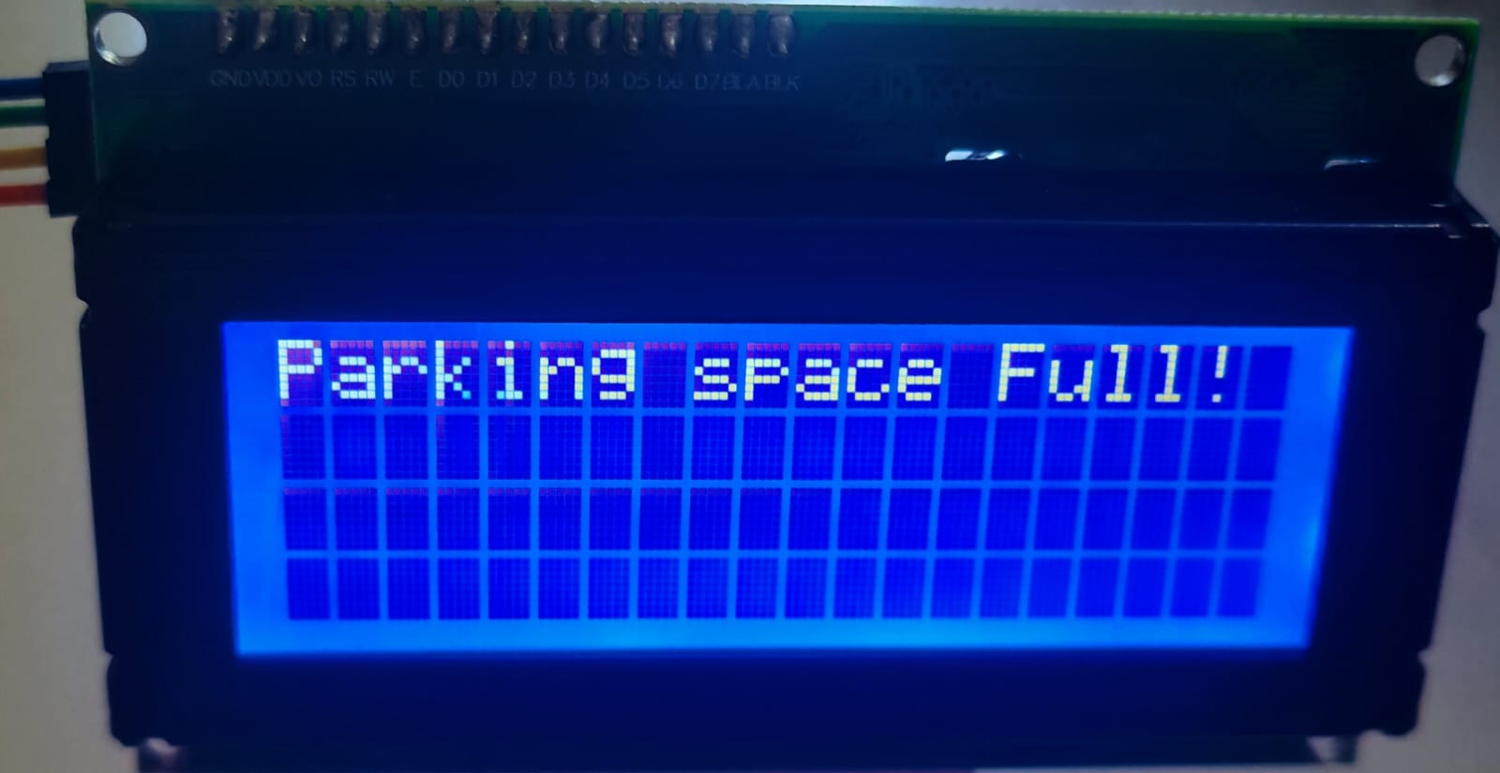
WORK FLOW
When the car exits, another IR sensor triggers the servo to close the gate and updates the slot count.
If all parking slots are occupied, the system displays ‘Parking Space Full!’ and keeps the gate closed to prevent entry.

Slide 9
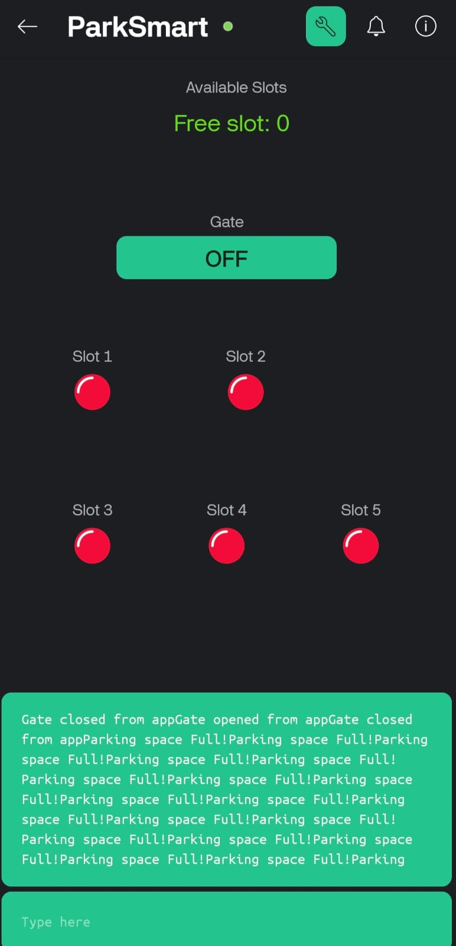
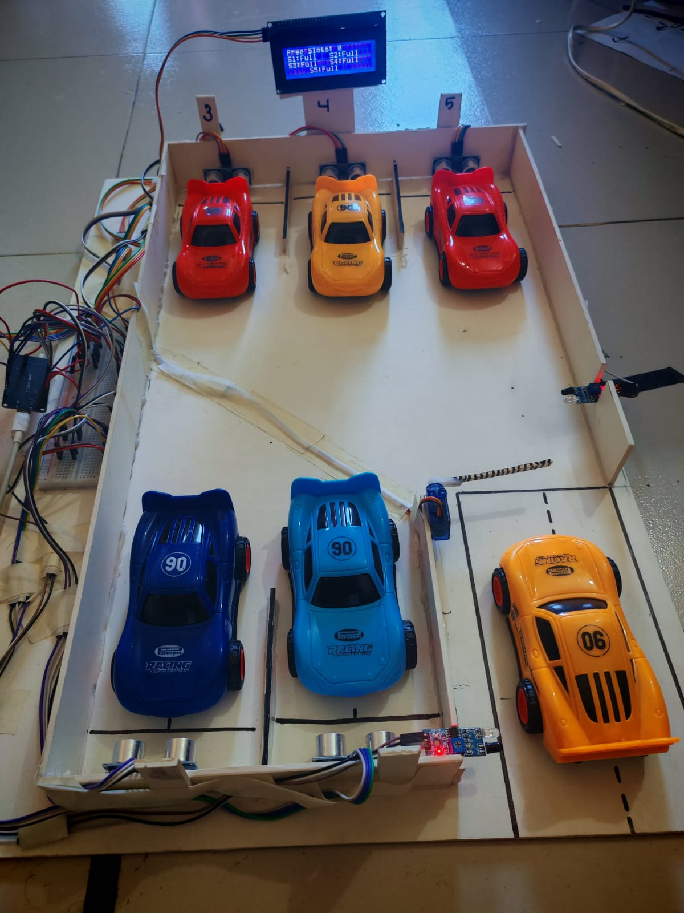
WORK FLOW
The Blynk app works like a remote control panel that connects to the ESP32 using Wi-Fi. When a car enters or leaves, the sensors update the data instantly and send it to the app. The user can easily see which parking slots are free or taken and how many spaces are available. This helps users check the parking status from anywhere using their phone.

Slide 10
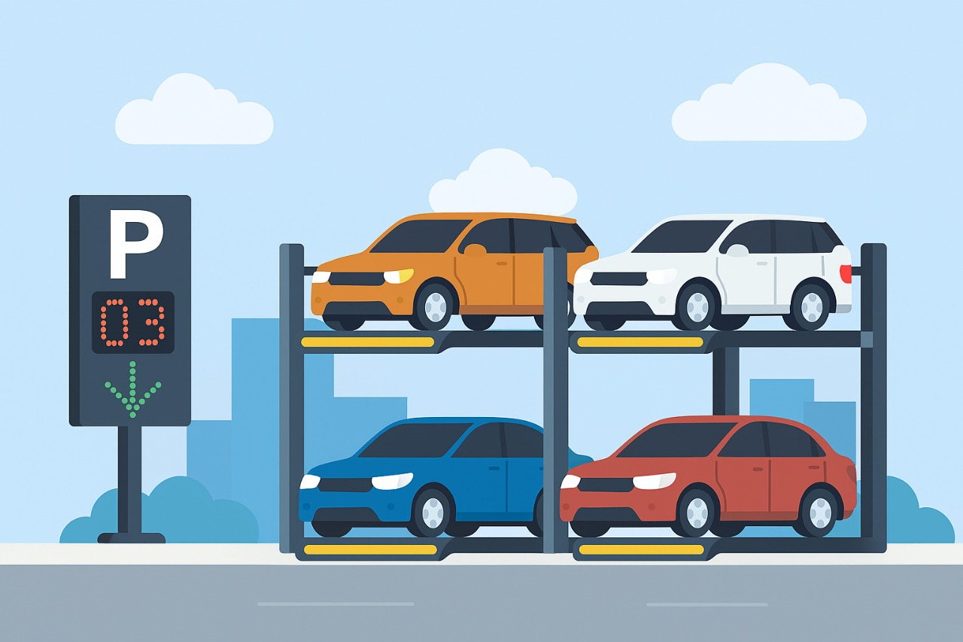
FUTURE SCOPE
Camera-Based Vehicle Detection: Use image processing or AI-based cameras to detect vehicle numbers and automatically record parking activity without sensors.
Online Booking System: Allow users to reserve parking slots in advance through a mobile app or website before arriving at the location.
Automatic Payment System: Integrate digital payment options (e.g., mobile banking, NFC, or QR code payments) for a seamless parking experience.
License Plate Recognition: Add an Automatic Number Plate Recognition system to identify vehicles and enhance security.
AI-Based Slot Prediction: Implement machine learning algorithms to predict peak hours and slot availability based on usage data.

Slide 11
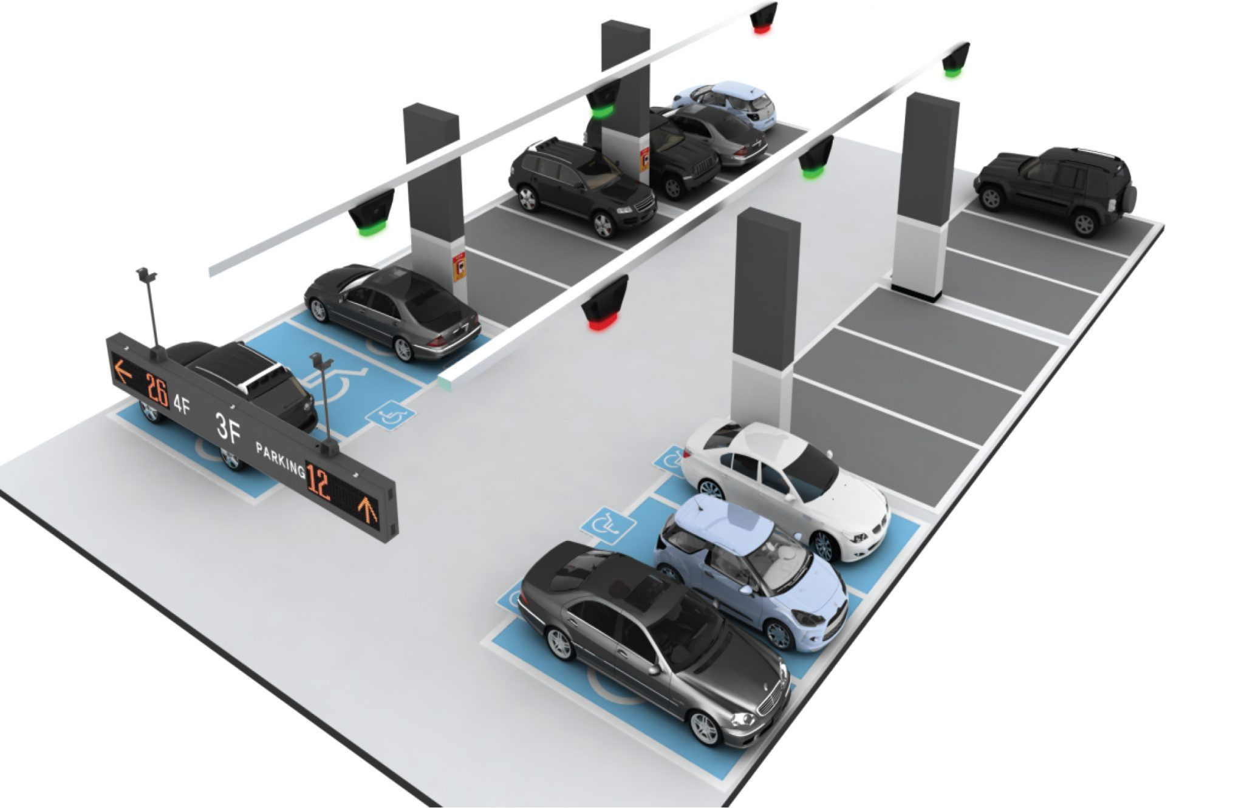
Our History
CONCLUSION
The Smart Parking System shows how IoT technology can effectively solve parking and traffic problems in modern cities. Using ESP32, sensors, servo motors, and the Blynk app, the system automates gate control and parking slot detection while providing real-time updates to users.
It helps reduce time, congestion, and fuel waste, making parking more convenient and eco-friendly. This cost-effective and scalable solution supports the vision of building smart and sustainable cities, contributing to the Smart Bangladesh initiative.
Add a main point
Add a main point
Add a main point
Elaborate on what you want to discuss.
Elaborate on what you want to discuss.
Elaborate on what you want to discuss.
Elaborate on what you want to discuss.

Slide 12
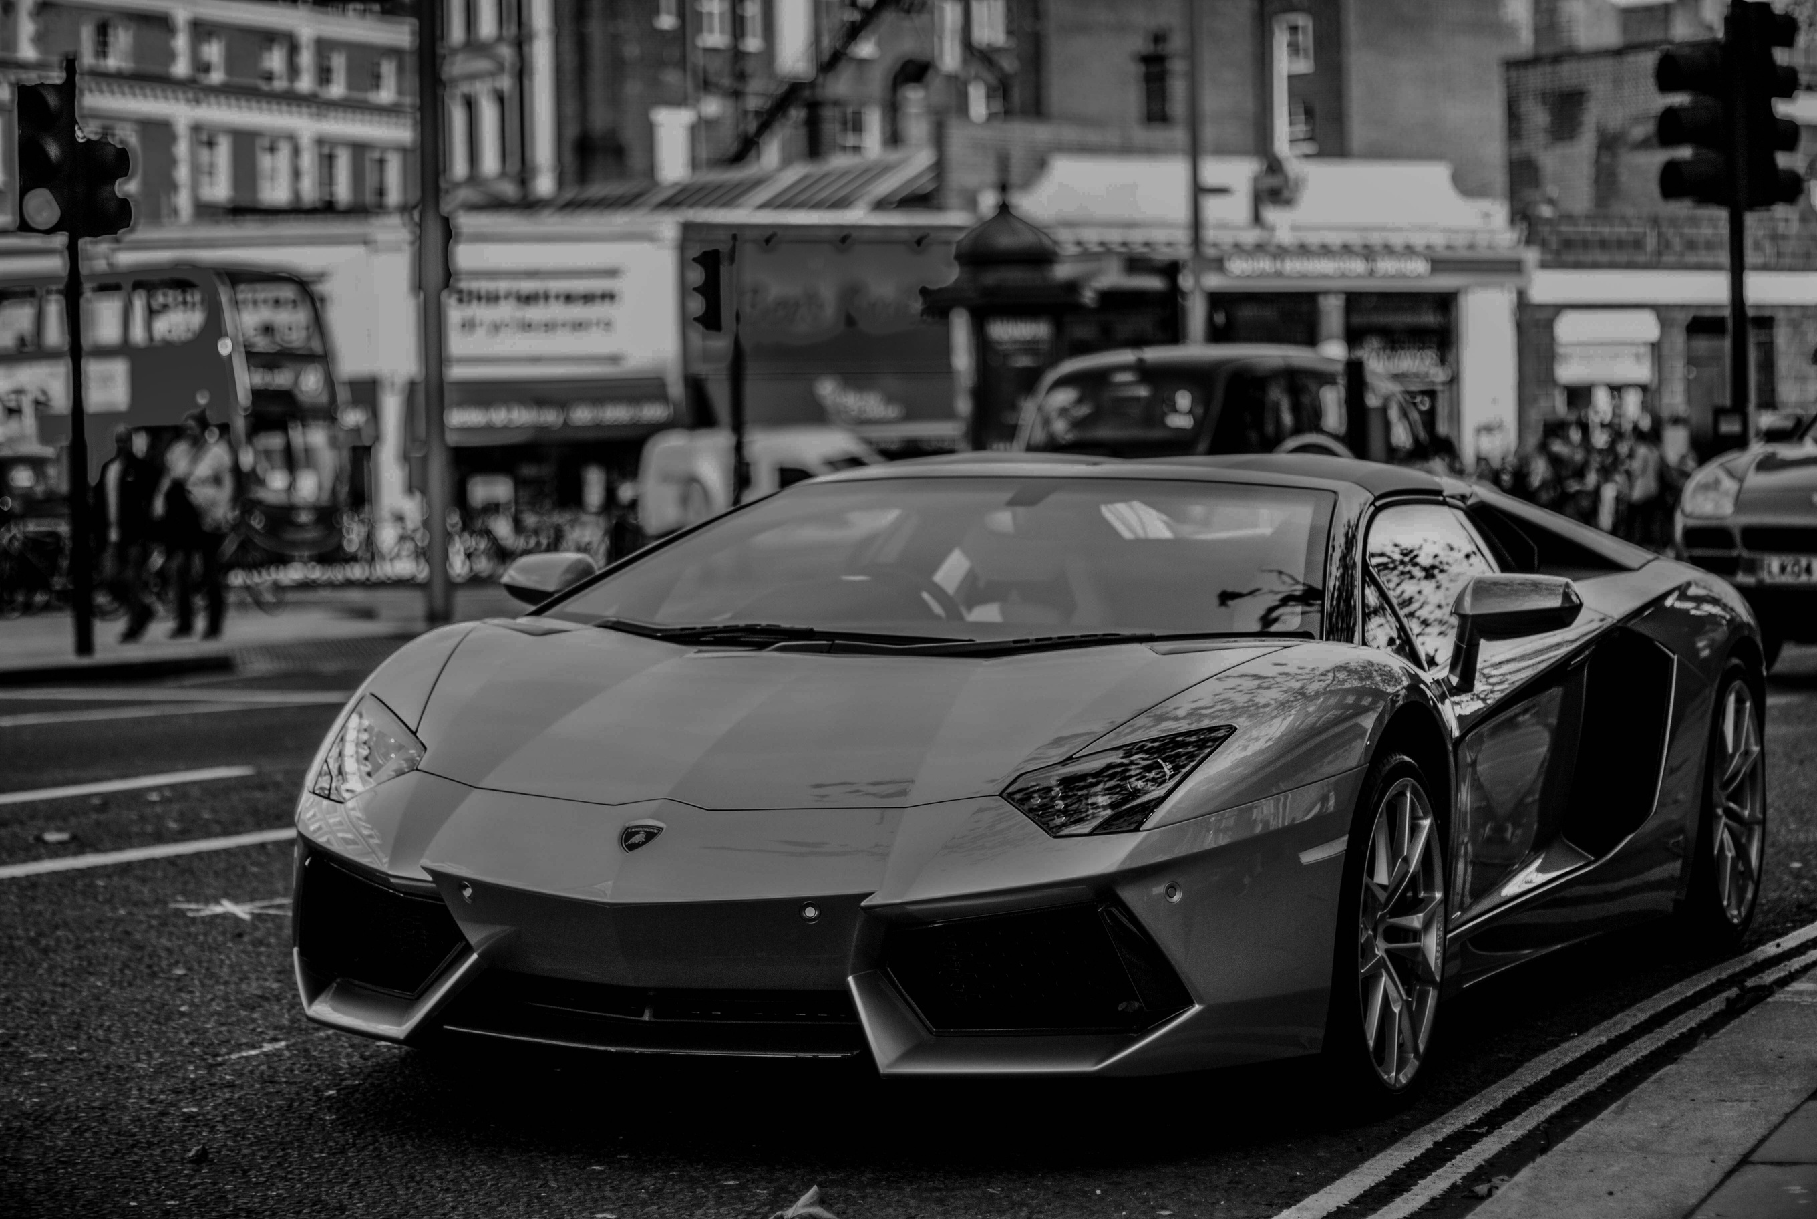
THANK YOU

